Slide 1
PROBABILITY AND DISTRIBUTION

Slide 2

Definition
Probability implies 'likelihood' or 'chance'. When an event is certain to happen then the probability of occurrence of that event is 1 and when it is certain that the event cannot happen then the probability of that event is 0.
Hence the value of probability ranges from 0 to 1.
The probabilities of event A is defined as given by the following probability function:

Slide 3
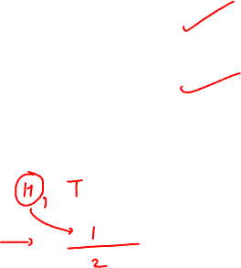
PROBABILITY
Example
Problem Statement:
A coin is tossed. What is the probability of getting a head?
Solution:
Number of outcomes favourable to head (m) = 1
Total number of outcomes (n) = 2 (i.e. head or tail)

Slide 4

PROBABILITY - Basic Concepts
Random Experiment
An experiment is said to be a random experiment, if it's out-come can't be predicted with certainty.
Example
If a coin is tossed, we can't say, whether head or tail will appear. So it is a random experiment.
Sample Space
The set of all possible out-comes of an experiment is called the sample space. It is denoted by 'S' and its number of elements are n(s).
Example
In throwing a dice, the number that appears at top is any one of 1,2,3,4,5,6. So here:
S ={1,2,3,4,5,6} and n(s) = 6
Similarly in the case of a coin, S={Head,Tail} or {H,T} and n(s)=2.

Slide 5
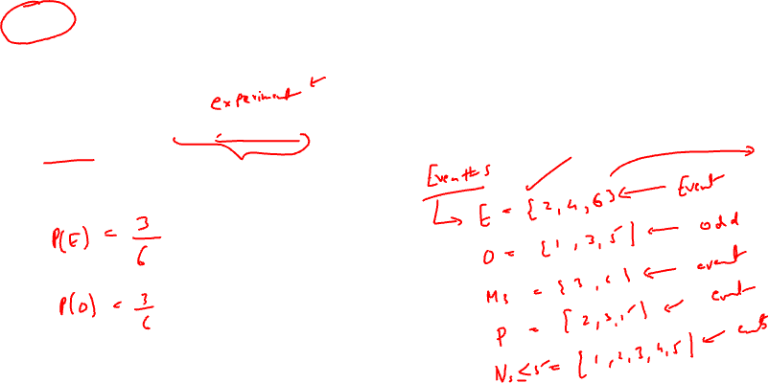
PROBABILITY - Basic Concepts
Event
Every subset of a sample space is an event. It is denoted by 'E'.
Example
In throwing a dice S={1,2,3,4,5,6}, the appearance of an even number will be the event E={2,4,6}.
Clearly E is a sub set of S.

Slide 6
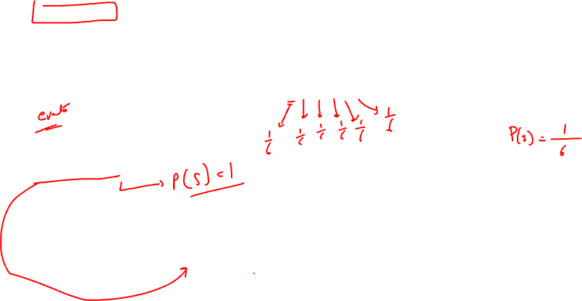
PROBABILITY - Basic Concepts
Equally likely events
Events are said to be equally likely, if the probability of occurrence of the events are same.
Example
When a dice is thrown, all the six faces {1,2,3,4,5,6} are equally likely to come up.
Exhaustive events
When every possible out come of an experiment is considered.
Example
A dice is thrown, cases 1,2,3,4,5,6 form an exhaustive set of events.

Slide 7
PROBABILITY - Basic Concepts
Mutually exclusive or Disjoint event
If two or more events can't occur simultaneously,
that is no two of them can occur together.
Example
When a coin is tossed, the event of occurrence of a head and the event of occurrence of a tail are mutually exclusive events.
Independent or Mutually independent events
Two or more events are said to be independent if occurrence or non-occurrence of any of them does not affect the probability of occurrence or non-occurrence of the other event.
Example
When a coin is tossed twice, the event of occurrence of head in the first throw and the event of occurrence of head in the second throw are independent events.
Difference between mutually exclusive and mutually independent events
Mutually exclusiveness is used when the events are taken from the same experiment, where as independence is used when the events are taken from different experiments.

Slide 8
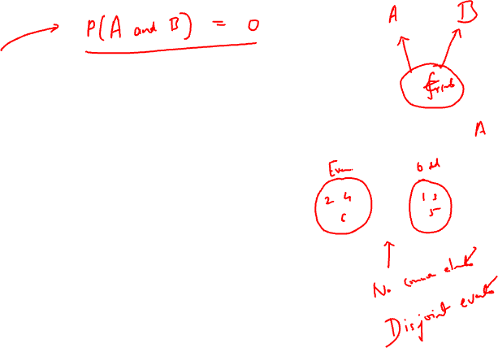

Mutually exclusive events:
Experiment: Throw a dice
Sample space ( S ) = { 1, 2, 3, 4, 5, 6}
A = occurrence of even numbers
A = {2 , 4 , 6} B = occurrence of odd numbers
B = {1, 3, 5}
What happens when we know that A has occurred?
What can we conclude about B?

Slide 9
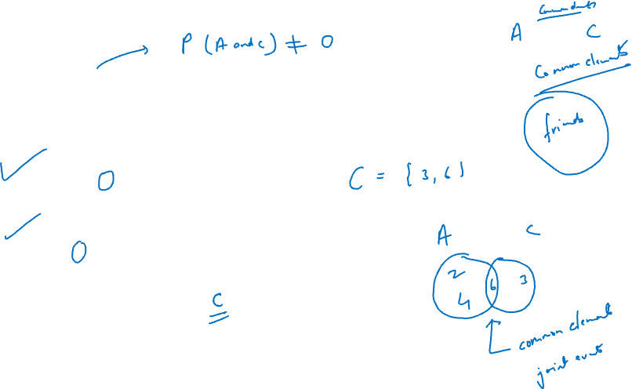
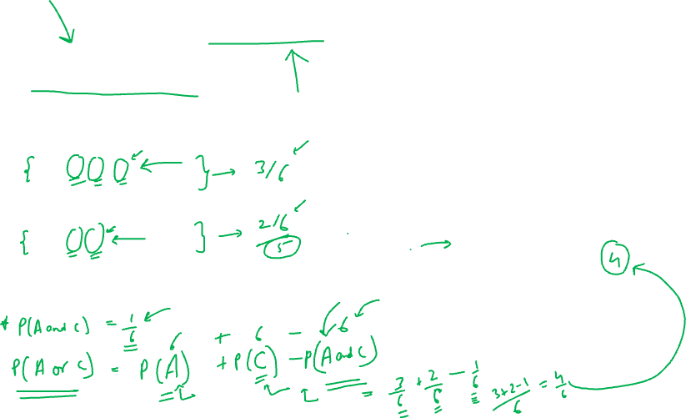
Joint events events:
Experiment: Throw a dice
Sample space ( S ) = { 1, 2, 3, 4, 5, 6}
A = occurrence of even numbers
A = {2 , 4 , 6}
C = A multiple of 3
C = {3, 6}
What happens when we know that A has occurred?
What can we conclude about B?

Slide 10
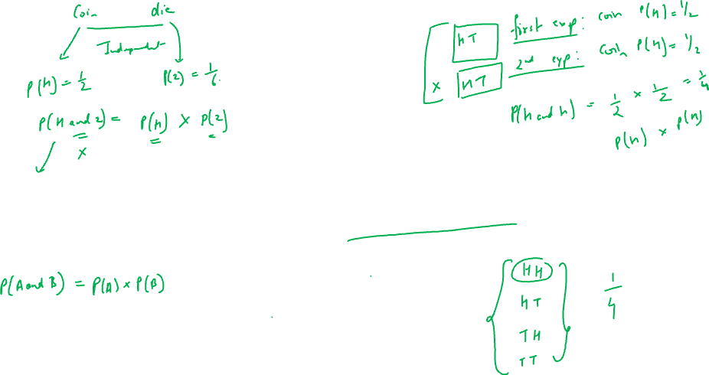
When the occurrence of one event , guarantees the non-occurrence of another event they are called mutually exclusive.

Slide 11
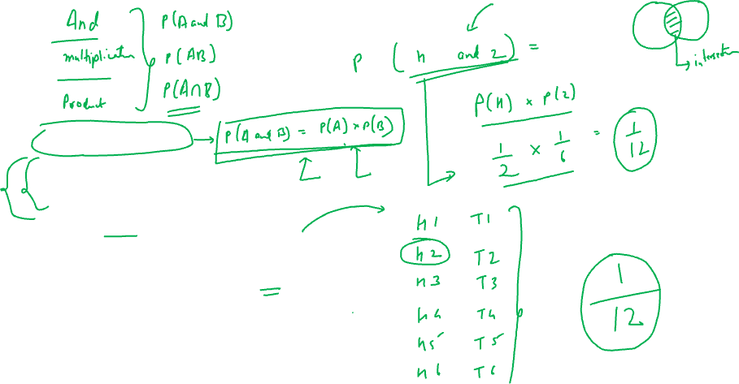
Independent events:
Experiment 1: Throw a dice
Experiment 2: toss a coin
Event A: Head on first coin
P(A) = ½
Event B: occurrence of number 2 on dice
P(B) = 1/6
Does occurrence of B depend on A?

Slide 12
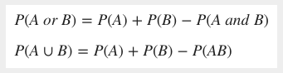
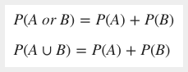
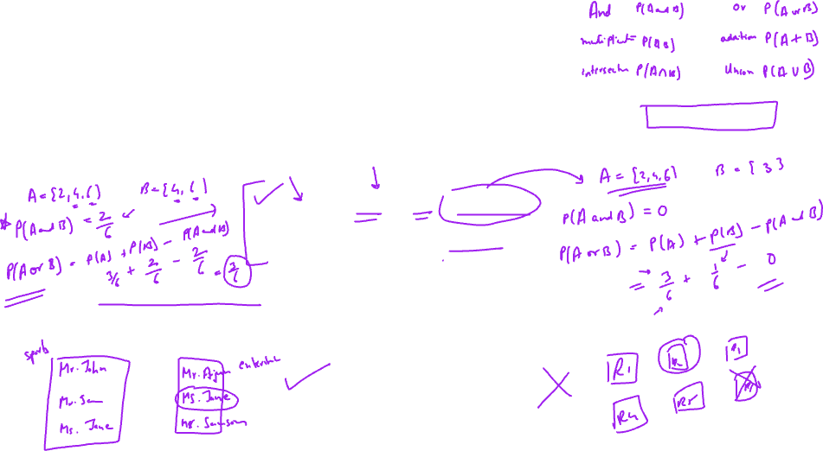
Additive theorem of probability
For Non Mutually Exclusive Events
Statement: If A and B are not mutually exclusive events, the probability of the occurrence of either A or B or both is equal to the probability that event A occurs, plus the probability that event B occurs minus the probability of occurrence of the events common to both A and B. In other words the probability of occurrence of at least one of them is given by
For Mutually Exclusive Events
Statement: If A and B are two mutually exclusive events, then the probability of occurrence of either A or B is the sum of the individual probabilities of A and B. Symbolically

Slide 13
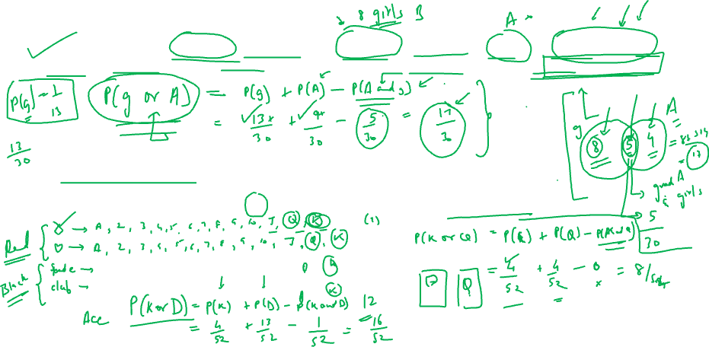
Additive theorem of probability - Examples
For Non Mutually Exclusive Events
1. In a math class of 30 students, 17 are boys and 13 are girls. On a unit test, 4 boys and 5 girls made an A grade. If a student is chosen at random from the class, what is the probability of choosing a girl or an A student?
For Mutually Exclusive Events
A card is drawn from a pack of 52, what is the probability that it is a king or a queen?

Slide 14

Quick Recap
Mutually Exclusive events: P(A and B) = 0
Independent Events : P(A and B) = P(A)*P(B)
Addition rule of probability for joint events:
P(A or B) = P(A) + P(B) – P(A and B)

Slide 15
MULTIPLICATIVE THEOREM/CONDITIONAL PROBABILITY - EXAMPLES
Independent Event: You have a cowboy hat, a top hat, and an Indonesian hat called a songkok. You also have four shirts: white, black, green, and pink. If you choose one hat and one shirt at random, what is the probability that you choose the songkok and the black shirt?

Slide 16
MULTIPLICATIVE THEOREM/CONDITIONAL PROBABILITY - EXAMPLES
Independent Event: You have a cowboy hat, a top hat, and an Indonesian hat called a songkok. You also have four shirts: white, black, green, and pink. If you choose one hat and one shirt at random, what is the probability that you choose the songkok and the black shirt?
The two events are independent events; the choice of hat has no effect on the choice of shirt.
There are three different hats, so the probability of choosing the songkok is 1/3 .
There are four different shirts, so the probability of choosing the black shirt is 1/4.
So, by the Multiplication Rule:
P(songkok and black shirt)=(1/3)⋅(1/4)=1/12

Slide 17
MULTIPLICATIVE THEOREM/CONDITIONAL PROBABILITY - EXAMPLES
Dependent Event: An urn contains 20 red and 10 blue balls. Two balls are drawn from a bag one after the other without replacement. What is the probability that both the balls drawn are red?

Slide 18
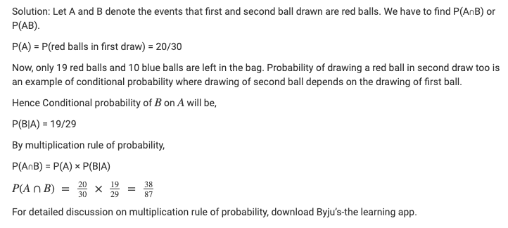
MULTIPLICATIVE THEOREM/CONDITIONAL PROBABILITY - EXAMPLES
Dependent Event: An urn contains 20 red and 10 blue balls. Two balls are drawn from a bag one after the other without replacement. What is the probability that both the balls drawn are red?

Slide 19
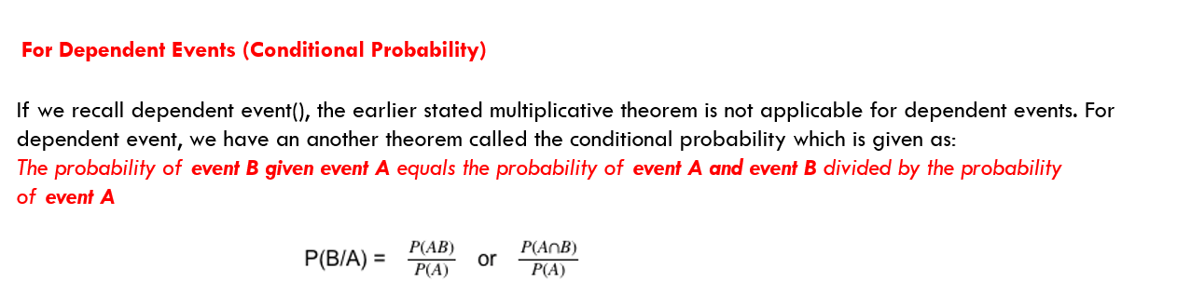

Slide 20
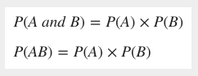
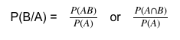
Multiplicative theorem of probability
For Independent Events
Statement: The theorem states that the probability of the simultaneous occurrence of two events that are independent is given by the product of their individual probabilities.
For Dependent Events (Conditional Probability)
If we recall dependent event(), the earlier stated multiplicative theorem is not applicable for dependent events. For dependent event, we have an another theorem called the conditional probability which is given as:
The probability of event B given event A equals the probability of event A and event B divided by the probability of event A

Slide 21
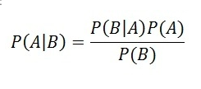


Bayes Theorem
Named after Thomas Bayes
Bayes' Theorem describes the probability of an event, based on prior knowledge of conditions that might be related to the event.
Note: This conditional probability is known as a hypothesis. This hypothesis is calculated through previous evidence or knowledge. This conditional probability is the probability of the occurrence of an event, given that some other event has already happened.
Example:
Suppose the weather of the day is cloudy. Now, you need to know whether it would rain today, given the cloudiness of the day. Therefore, you are supposed to calculate the probability of rainfall, given the evidence of cloudiness.

Slide 22
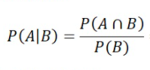
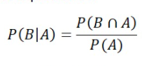
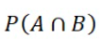
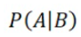
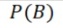
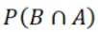
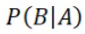
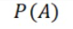
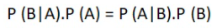
Bayes Theorem – From where it came?
We know from Conditional Probability:
Rearranging Equation 1:
=
*
Similarly:
=
*
=
Finally:

Slide 23
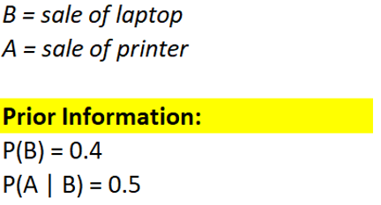
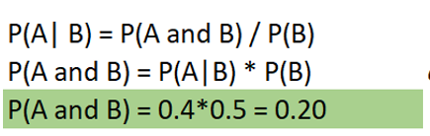
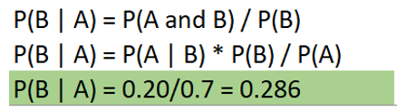
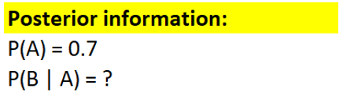

Slide 24
B
A
P(B’ and A)
P(B and A)
P( A ) = P(B ∩ A) + P(B’ ∩ A)

Slide 25
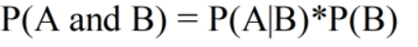
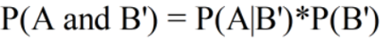
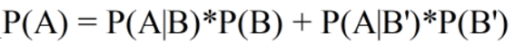
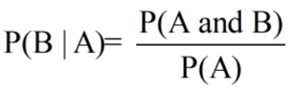
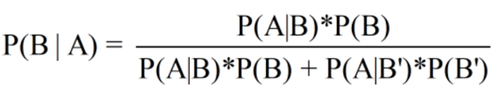
Generalized Baye’s Formula

Slide 26
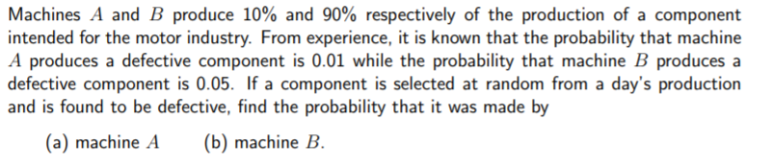

Slide 27
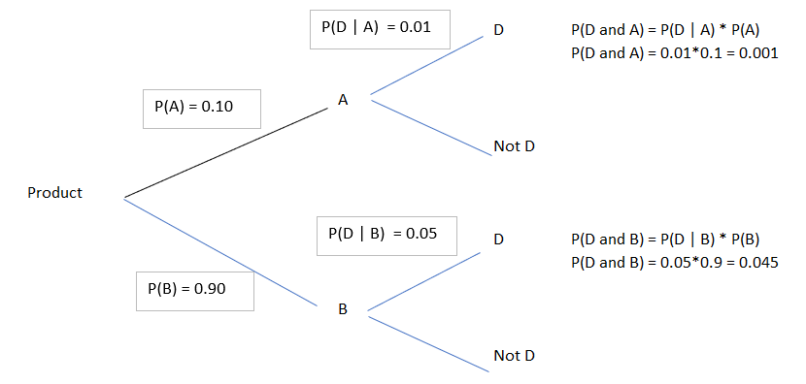
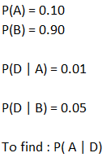
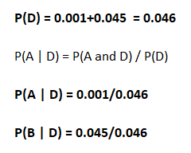

Slide 28
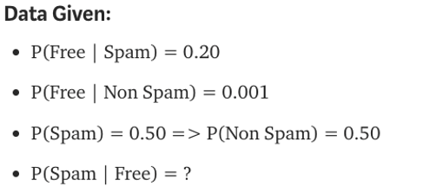
Bayes Theorem - Examples
Symantec works by having users train the system. It looks for patterns in the words in emails marked as spam by the user. For example, it may have learned that the word “free” appears in 20% of the emails marked as spam. Assuming 0.1% of non-spam mail includes the word “free” and 50% of all emails received by the user is spam, find the probability that a mail is a spam if the word “free” appears in it.
Solution:

Slide 29
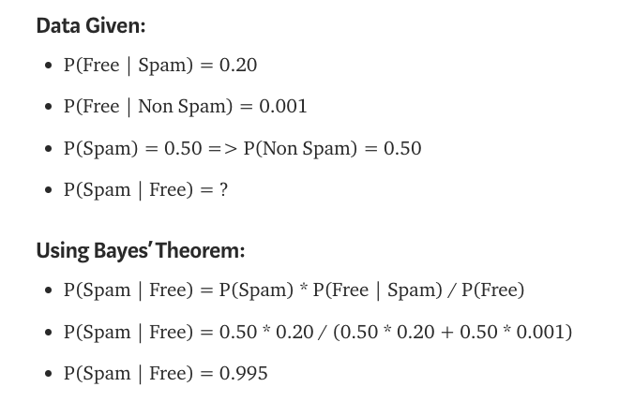
Bayes Theorem - Examples
Symantec works by having users train the system. It looks for patterns in the words in emails marked as spam by the user. For example, it may have learned that the word “free” appears in 20% of the emails marked as spam. Assuming 0.1% of non-spam mail includes the word “free” and 50% of all emails received by the user is spam, find the probability that a mail is a spam if the word “free” appears in it.
Solution:

Slide 30
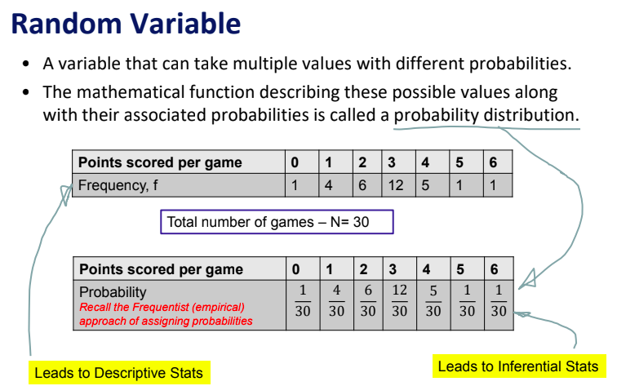
Random Variables – Discrete/Continuous

Slide 31
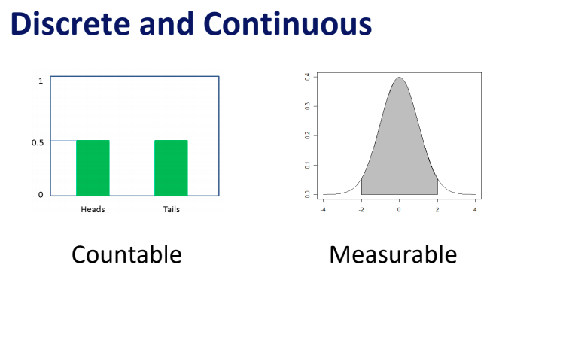
Random Variable Types

Slide 32
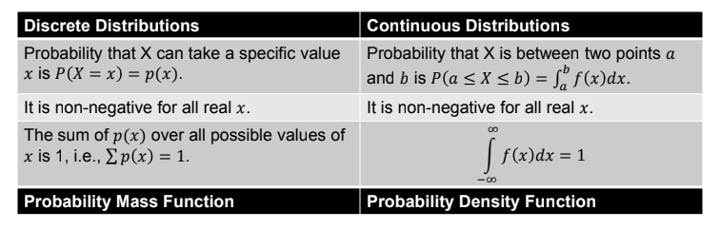
Probability Mass Function/Probability Density Function

Slide 33
DISCRETE DISTRIBUTIONS - Binomial Distribution
A distribution where only two outcomes are possible, such as success or failure, gain or loss, win or lose and where the probability of success and failure is same for all the trials is called a Binomial Distribution.
The outcomes need not be equally likely.
Each trial is independent.
A total number of n identical trials are conducted.
The probability of success and failure is same for all trials. (Trials are identical.)
Mathematical Representation

Slide 34
Probability that a product is defective is 0.20. If 10 products are selected what is the probability that exactly 3 products are defective?
Mathematical Representation

Slide 35
CONTINUOUS DISTRIBUTION – NORMAL Distribution
Normal distribution represents the behaviour of most of the situations in the universe (That is why it’s called a “normal” distribution.)
The large sum of (small) random variables often turns out to be normally distributed, contributing to its widespread application.
Characteristics:
The mean, median and mode of the distribution coincide.
The curve of the distribution is bell-shaped and symmetrical about the line x=μ.
The total area under the curve is 1.
Exactly half of the values are to the left of the center and the other half to the right.
A normal distribution is highly different from Binomial Distribution. However, if the number of trials approaches infinity then the shapes will be quite similar.

Slide 36
A company manufactures 100 units on an average with a standard deviation of 10.
What are the chances that in the present month the company ends up producing at the most 110 units?

Slide 37
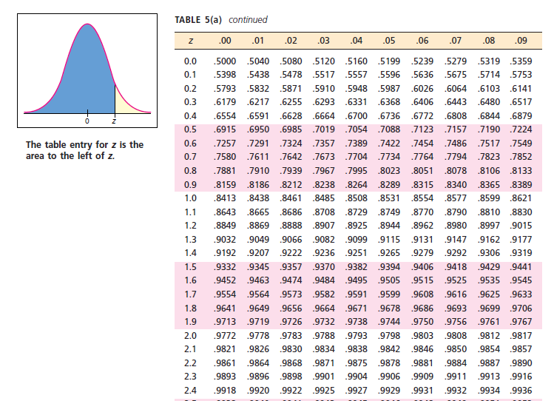

Slide 38
A company manufactures 100 units on an average with a standard deviation of 10.
What are the chances that in the present month the company ends up producing at the most 90 units?

Slide 39
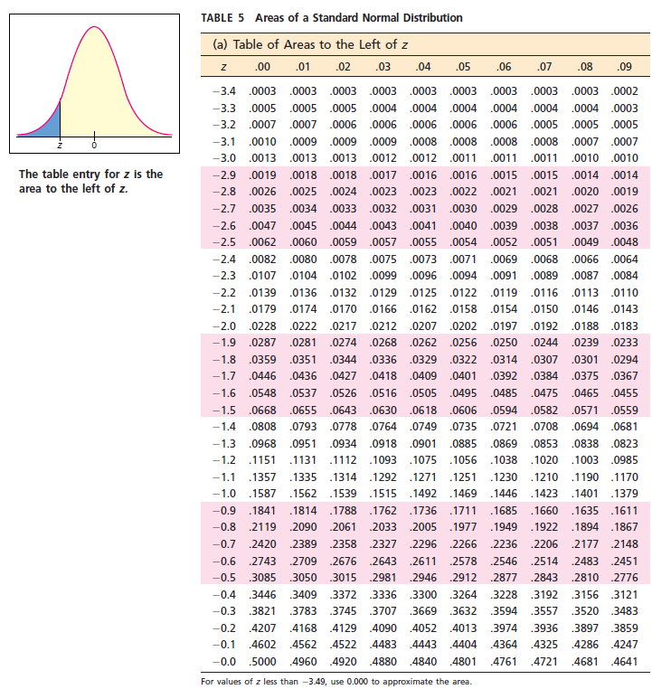

Slide 40
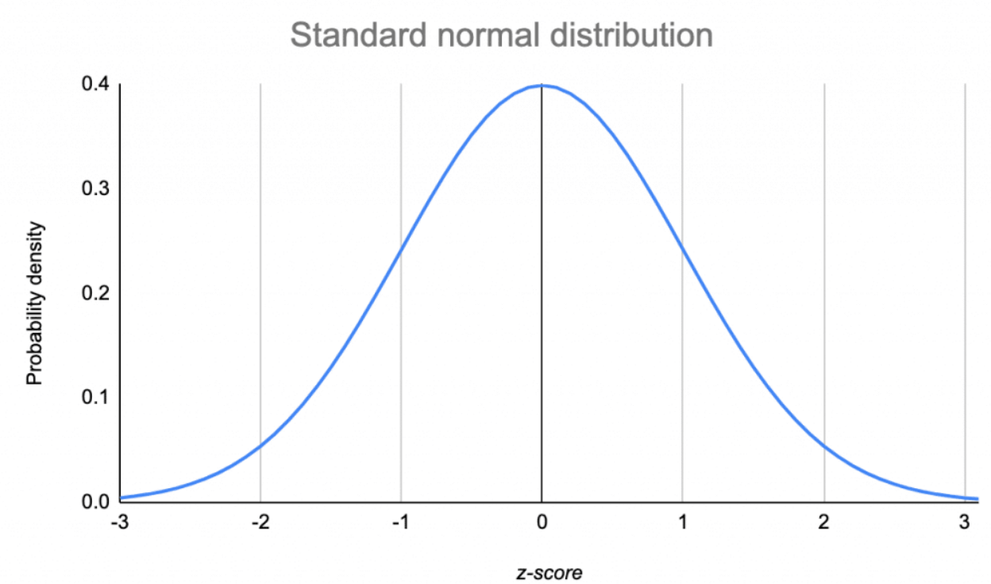

Slide 43
NORMAL Distribution – Empirical Rule
The empirical rule states that for a normal distribution, nearly all of the data will fall within three standard deviations of the mean. The empirical rule can be broken down into three parts:
68% of data falls within the first standard deviation from the mean.
95% fall within two standard deviations.
99.7% fall within three standard deviations.
The rule is also called the 68-95-99 7 Rule or the Three Sigma Rule.

Slide 44
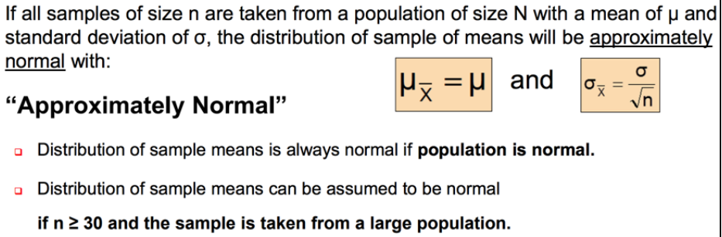

Slide 45
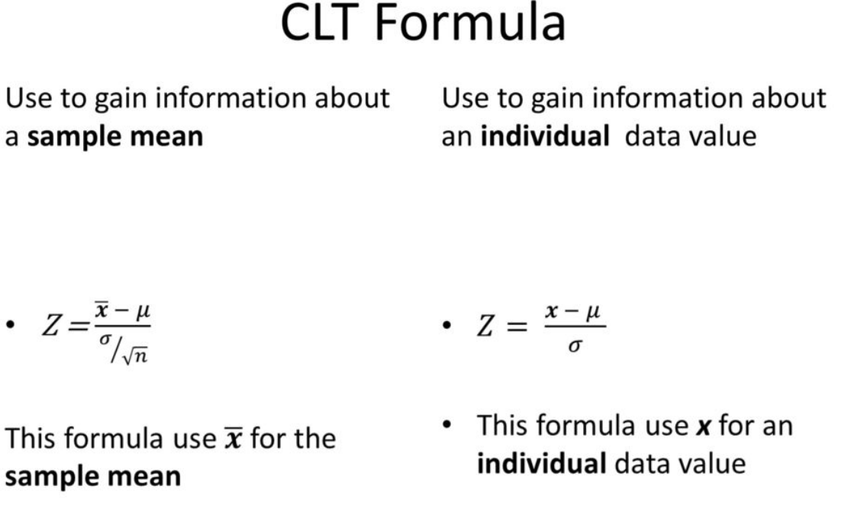

Slide 46
NORMAL Distribution – Central Limit theorem
Central Limit Theorem (Key Takeaways)
The central limit theorem (CLT) states that the distribution of sample means approximates a normal distribution as the sample size gets larger.
Sample sizes equal to or greater than 30 are considered sufficient for the CLT to hold.
A key aspect of CLT is that the average of the sample means and standard deviations will equal the population mean and standard deviation.
A sufficiently large sample size can predict the characteristics of a population accurately.
Expectation of Sample Mean as a random variable = Population Mean. Symbolically E(X̄) = µ.
Standard Deviation (X̄) = σ / √n (where σ is standard deviation and n is sample size).

